Slide 1
ILSMC: a phylogenetically aware SMC to infer the evolutionary history of species
Iker Rivas-González

Slide 2
Overview
Incomplete lineage sorting (ILS)
HMMs: CoalHMM and SMCs
ILSMC
The hidden states
The CTMCs
The transition probability matrix
Simulating from the model
Discussion

Slide 3
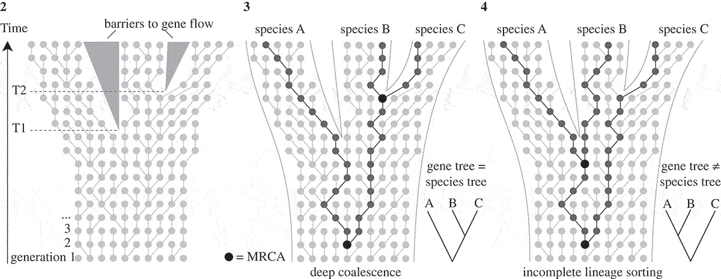
Incomplete lineage sorting (ILS)
Modified from Leliaert et al. (2013)
Notes:
- Three species, two speciation events.
- If 1st coal between T1 and T2 -> gene tree = species tree
- If 1st coal escapes T2 -> maybe gene tree != species tree
- This is called ILS.
- Usually regarded as an obstacle for phylogenetic reconstruction.
- But valuable -> information-rich about speciation times and ancestral population sizes.

Slide 4
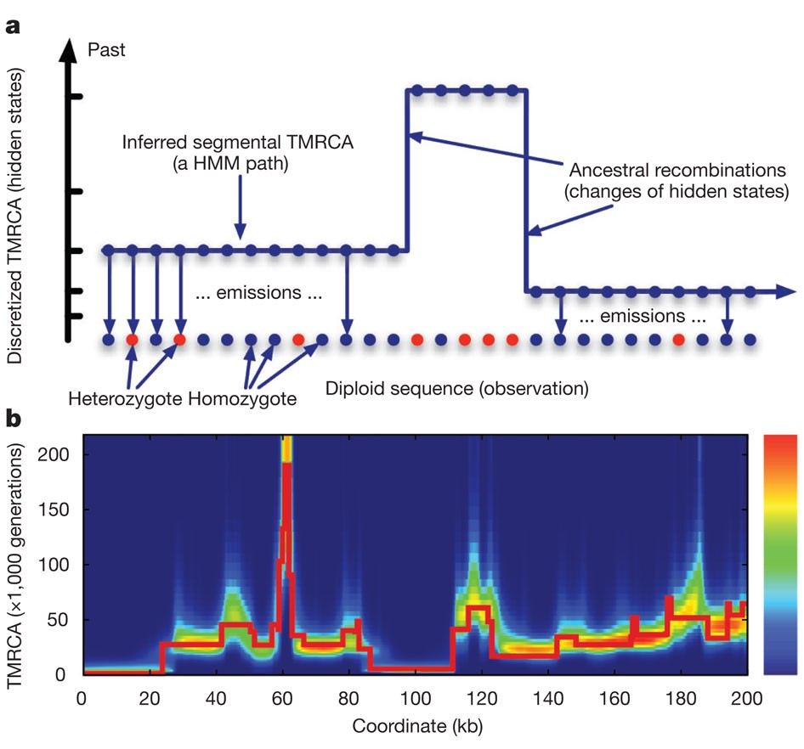
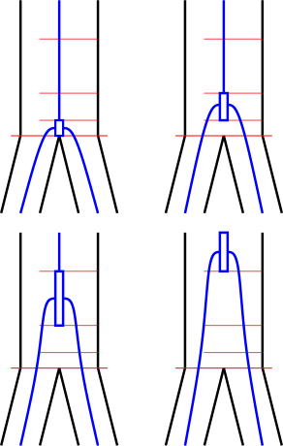
HMMs
SMCs
Li and Durbin (2011)
Notes:
- Sequentially Markovian coalescents
- Hidden states are discretized time intervals.
- Useful to model changes in Ne through time.
- Drawback: only one coalescent.
- CoalHMM:
-hidden states are phylogenetic trees
- V0: canonical topology
- V1, V2, V3: the others deep coalescence
- V2, V3: alternative topologies (ILS).
- Useful to infer spec times & ancestral Ne.
- Drawback: biased parameters.

Slide 5
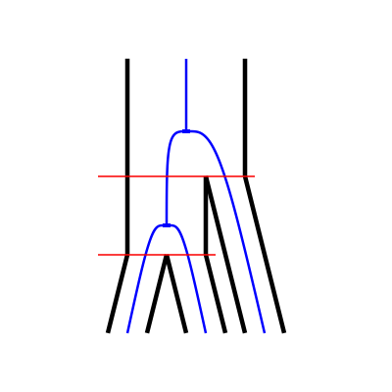
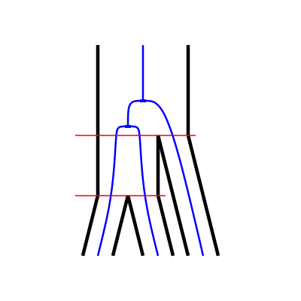
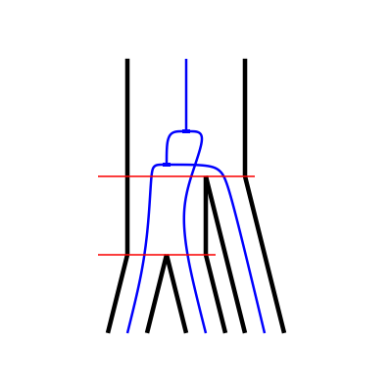
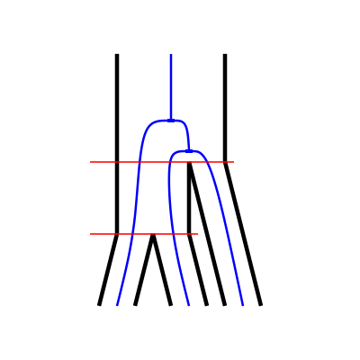
HMMs
V0
V1
CoalHMM
SMCs
V2
V3
Notes:
- Sequentially Markovian coalescents
- Hidden states are discretized time intervals.
- Useful to model changes in Ne through time.
- Drawback: only one coalescent.
- CoalHMM:
-hidden states are phylogenetic trees
- V0: canonical topology
- V1, V2, V3: the others deep coalescence
- V2, V3: alternative topologies (ILS).
- Useful to infer spec times & ancestral Ne.
- Drawback: biased parameters.

Slide 6
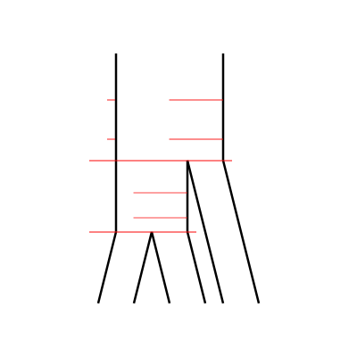
ILSMC
Extract the ILS information CoalHMM-style
Parameterize with discretized time intervals SMC-style
Notes:
- Combine the two approaches.

Slide 7
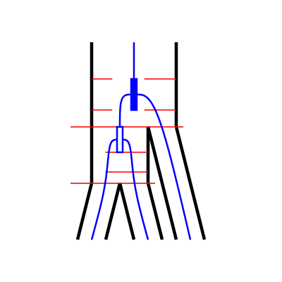
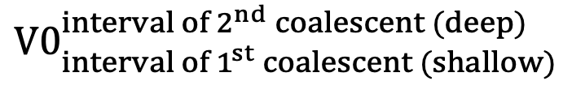
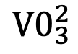
The hidden states
$${V0}_{3}^{2}$$
3
Deep
2
1
3
Shallow
2
1
$${V0}_{{interval of 1}^{st} coalescent (shallow)}^{{interval of 2}^{nd} coalescent (deep)}$$
Notes:
- New hidden states: phylogenetic trees with two discretized coalescent events.
- V0 -> set of V0 states, each with a combination of coal times.

Slide 8
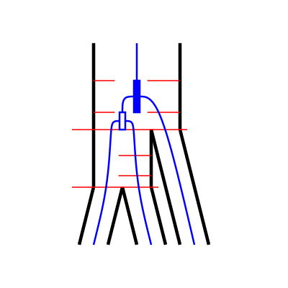
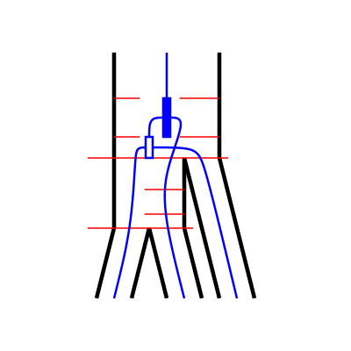
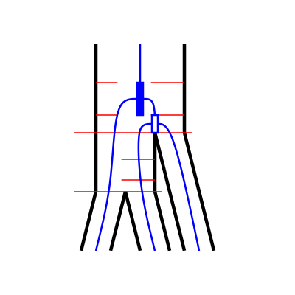
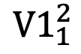
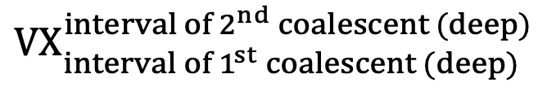
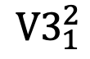
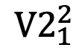
The hidden states
$${V0}_{3}^{2}$$
$${V1}_{1}^{2}$$
$${V2}_{1}^{2}$$
$${V3}_{1}^{2}$$
3
3
3
3
Deep
2
Deep
2
Deep
2
Deep
2
1
1
1
1
3
3
3
3
Shallow
Shallow
Shallow
Shallow
2
2
2
2
1
1
1
1
$${V0}_{{interval of 1}^{st} coalescent (shallow)}^{{interval of 2}^{nd} coalescent (deep)}$$
$${VX}_{{interval of 1}^{st} coalescent (deep)}^{{interval of 2}^{nd} coalescent (deep)}$$
Notes:
- New hidden states: phylogenetic trees with two discretized coalescent events.
- V0 -> set of V0 states, each with a combination of coal times.

Slide 9
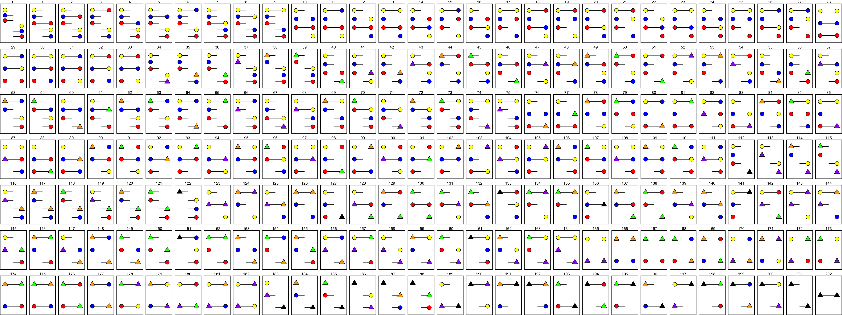
The CTMCs
Three-sequence CTMC
Two-sequence CTMC
One-sequence CTMC
One-sequence CTMC
One-sequence CTMC
Notes:
- ILSMC is built by interconnected CTMCs (continuous-time Markov chains).
- These are needed to get the transition probability matrix of ILSMC.

Slide 10
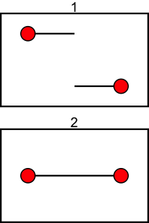
The CTMCs
1R
1C

Slide 11
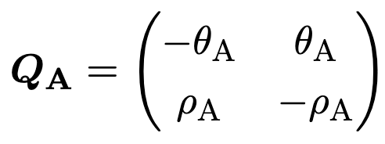
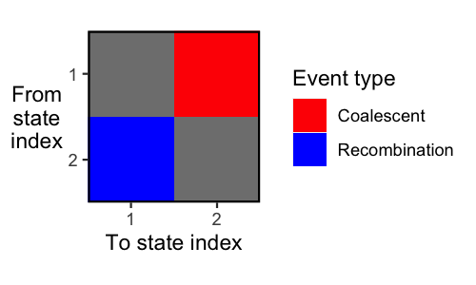
The CTMCs
1R
1C

Slide 12
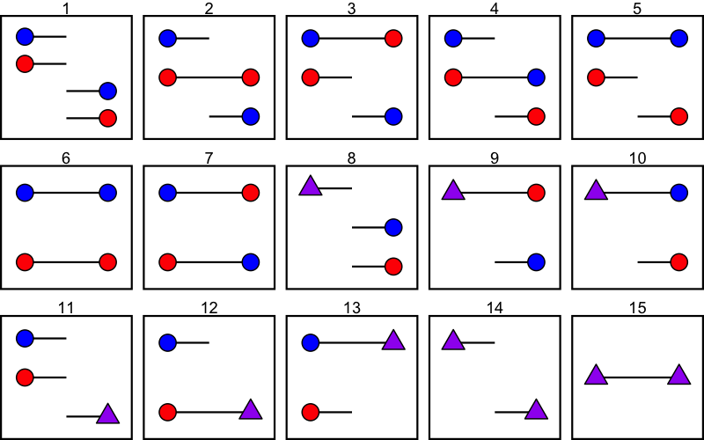
The CTMCs

Slide 13
The CTMCs
AB BC
3 6
A B C
1 2 4
ABC
7
AC
5

Slide 14
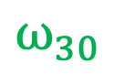
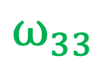
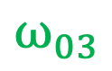
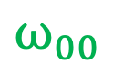
The CTMCs
$$ω_{00}$$
AB BC
3 6
A B C
$$ω_{30}$$
1 2 4
ABC
7
$$ω_{03}$$
AC
$$ω_{33}$$
5

Slide 15
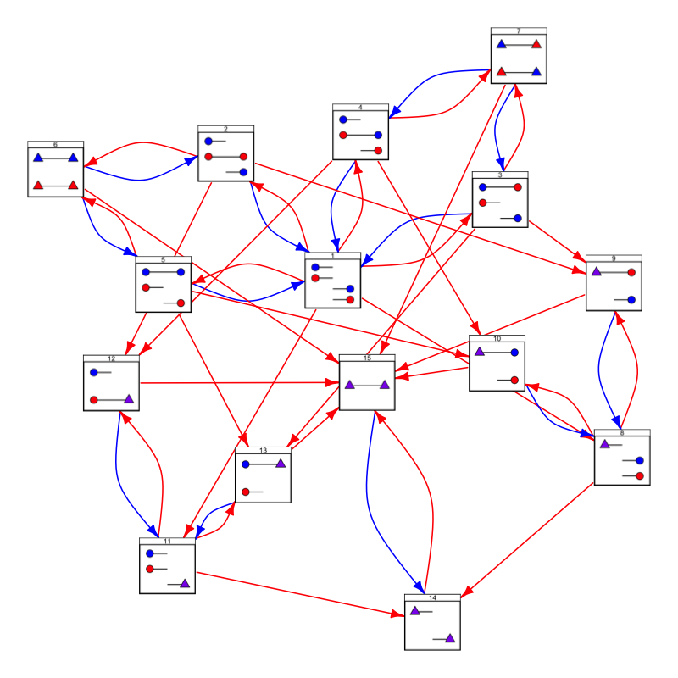
The CTMCs

Slide 16
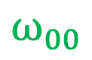
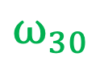
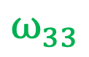
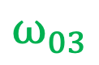
The CTMCs
$$ω_{00}$$
$$ω_{30}$$
$$ω_{03}$$
$$ω_{33}$$

Slide 17
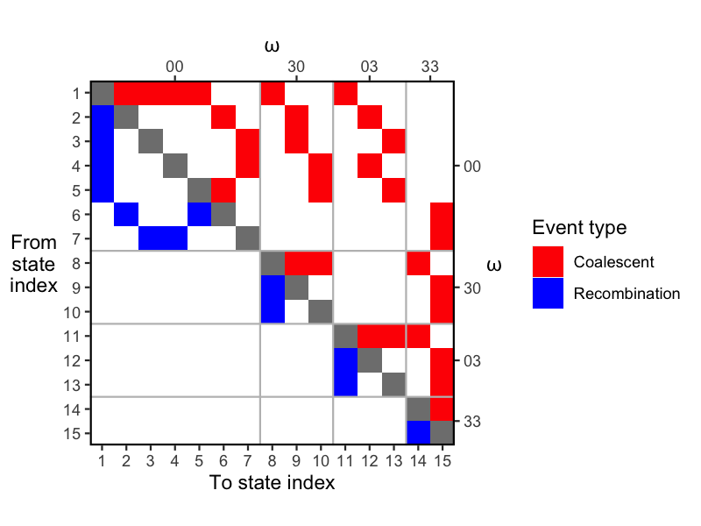
The CTMCs

Slide 18
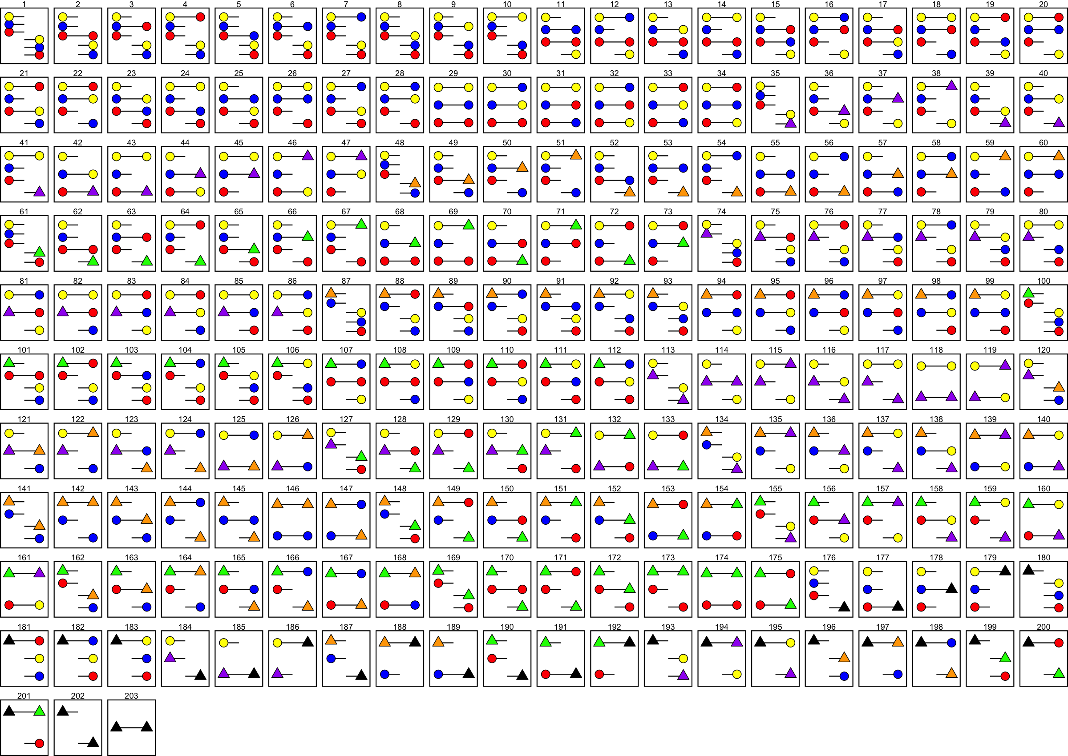
The CTMCs

Slide 19
The CTMCs
AB BC
3 6
A B C
1 2 4
ABC
7
AC
5

Slide 20
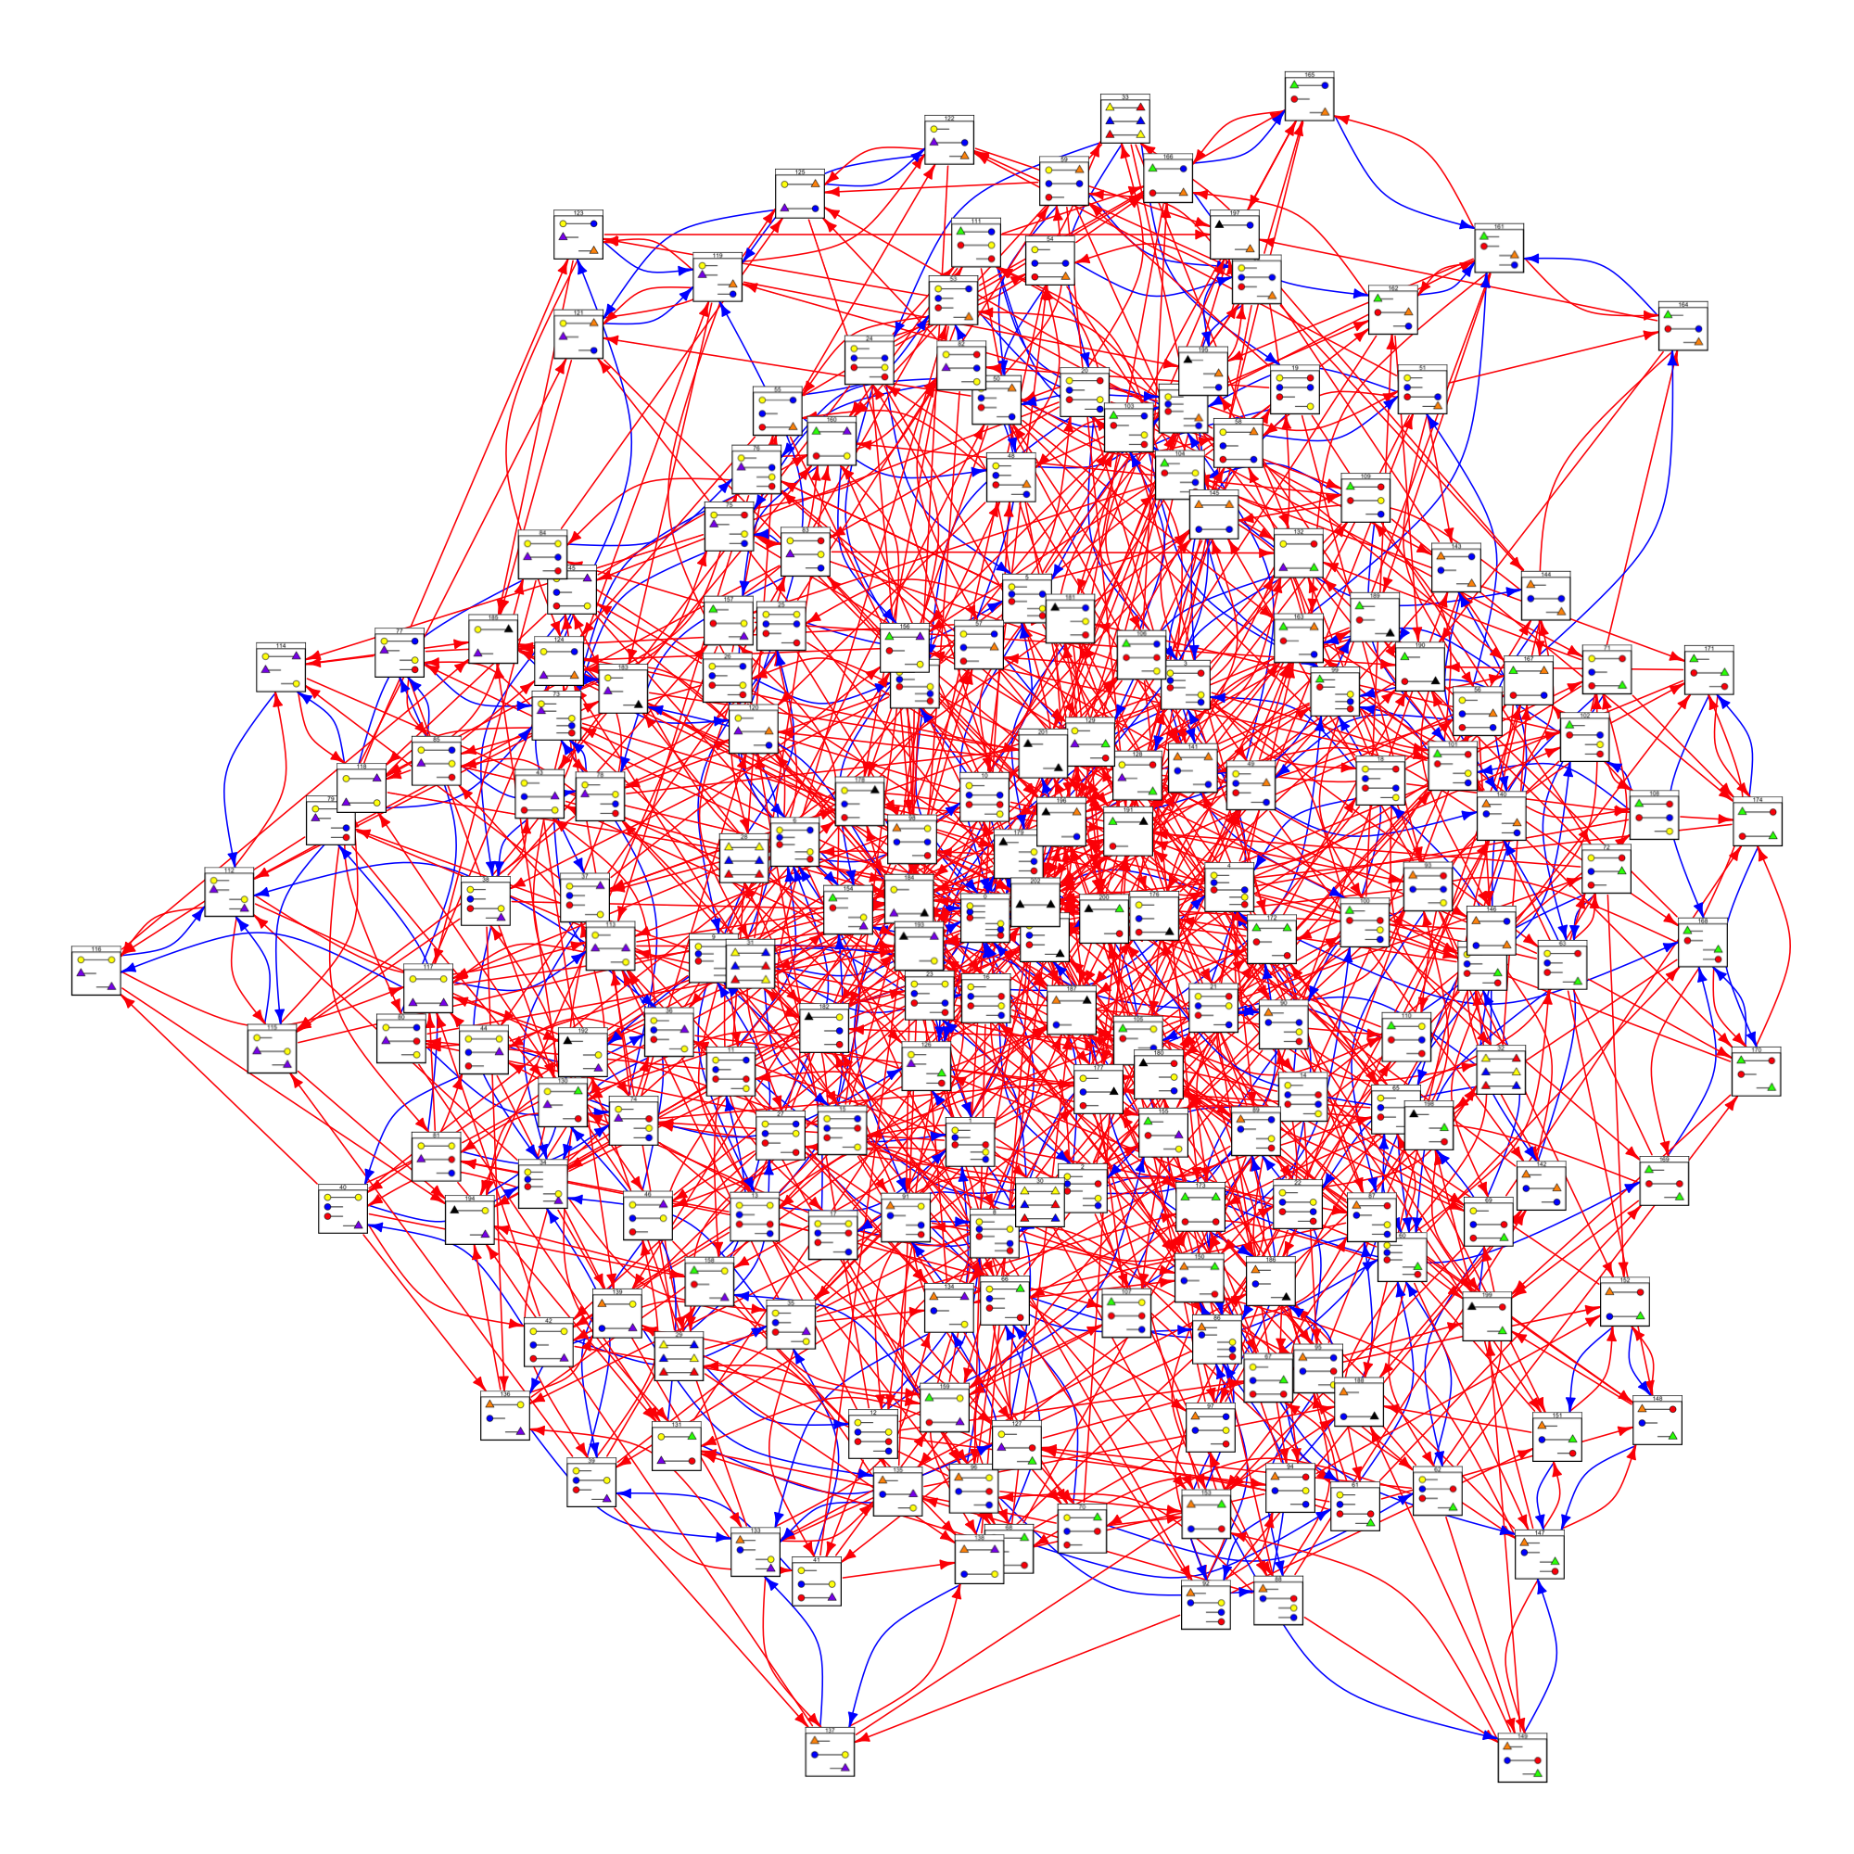
The CTMCs

Slide 21
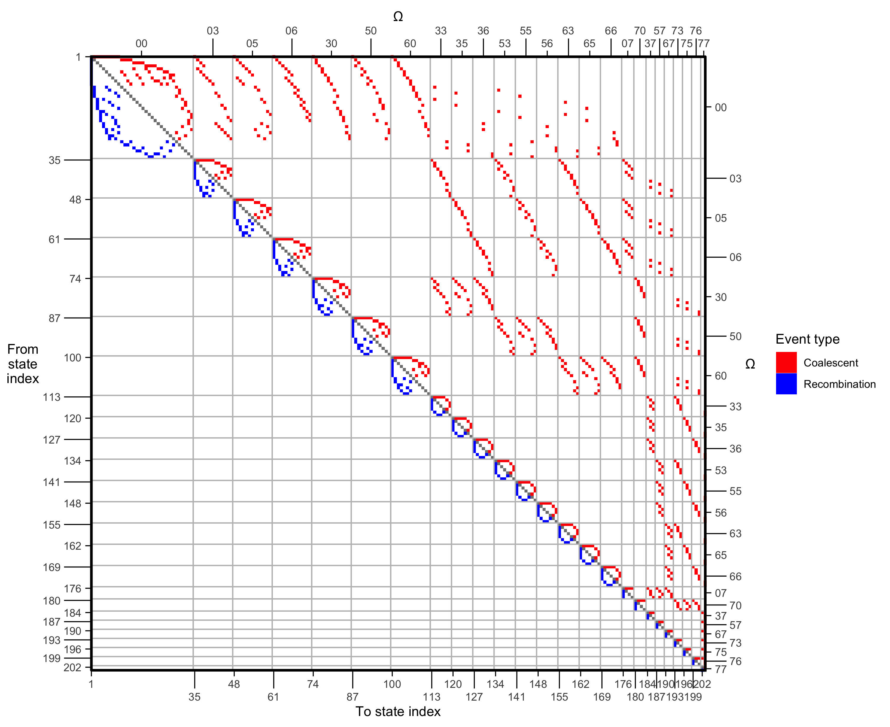
The CTMCs

Slide 22
The CTMCs
AB BC
3 6
A B C
1 2 4
ABC
7
AC
5

Slide 23
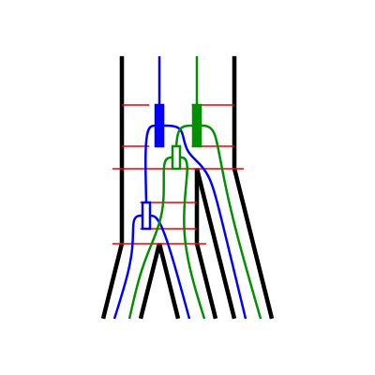
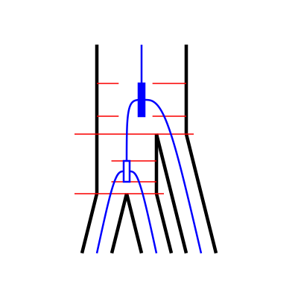
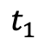
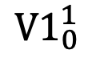
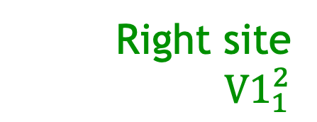
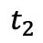
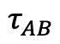
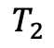
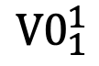
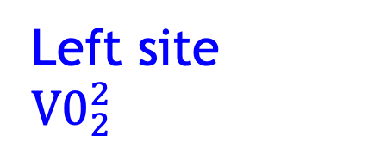
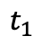
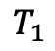
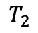
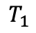





The transition probability matrix
Right site
${V1}_{1}^{2}$
Left site
$${V0}_{2}^{2}$$
Left site
Right site
${V0}_{1}^{1}→{V1}_{0}^{1}$:
3 one-sequence CTMCs:
For A and B until $τ_{AB}$
For C until $τ_{ABC}$
Two-sequence CTMC:
No coalescence on L or R $(τ_{AB}$-$t_{1})$
1st coalescent on L and no coalescent on R $(t_{1}$-$t_{2})$
No coalescent on L or R $(t_{2}$-$τ_{ABC})$
Three-sequence CTMC:
No coalescent on L and 1st coalescent on R $(τ_{ABC}$-$T_{1})$
2nd coalescent on both L and R $(T_{1}$-$T_{2})$
$${V0}_{1}^{1}$$
$${V1}_{0}^{1}$$
$$T_{2}$$
$$T_{1}$$
$$T_{2}$$
$$τ_{ABC}$$
$$T_{1}$$
$$τ_{ABC}$$
$$t_{2}$$
$$t_{2}$$
$$t_{1}$$
$$t_{1}$$
$$τ_{AB}$$
$$τ_{AB}$$

Slide 24

The transition probability matrix
Right site
${V1}_{1}^{2}$
Left site
$${V0}_{2}^{2}$$
Left site
Right site
${V0}_{1}^{1}→{V1}_{0}^{1}$:
3 one-sequence CTMCs:
For A and B until $τ_{AB}$
For C until $τ_{ABC}$
Two-sequence CTMC:
No coalescence on L or R $(τ_{AB}$-$t_{1})$
1st coalescent on L and no coalescent on R $(t_{1}$-$t_{2})$
No coalescent on L or R $(t_{2}$-$τ_{ABC})$
Three-sequence CTMC:
No coalescent on L and 1st coalescent on R $(τ_{ABC}$-$T_{1})$
2nd coalescent on both L and R $(T_{1}$-$T_{2})$
$${V0}_{1}^{1}$$
$${V1}_{0}^{1}$$
$$T_{2}$$
$$T_{1}$$
$$T_{2}$$
$$τ_{ABC}$$
$$T_{1}$$
$$τ_{ABC}$$
$$t_{2}$$
$$t_{2}$$
$$t_{1}$$
$$t_{1}$$
$$τ_{AB}$$
$$τ_{AB}$$

Slide 25

The transition probability matrix
Right site
${V1}_{1}^{2}$
Left site
$${V0}_{2}^{2}$$
Left site
Right site
${V0}_{1}^{1}→{V1}_{0}^{1}$:
3 one-sequence CTMCs:
For A and B until $τ_{AB}$
For C until $τ_{ABC}$
Two-sequence CTMC:
No coalescence on L or R $(τ_{AB}$-$t_{1})$
1st coalescent on L and no coalescent on R $(t_{1}$-$t_{2})$
No coalescent on L or R $(t_{2}$-$τ_{ABC})$
Three-sequence CTMC:
No coalescent on L and 1st coalescent on R $(τ_{ABC}$-$T_{1})$
2nd coalescent on both L and R $(T_{1}$-$T_{2})$
$${V0}_{1}^{1}$$
$${V1}_{0}^{1}$$
$$T_{2}$$
$$T_{1}$$
$$T_{2}$$
$$τ_{ABC}$$
$$T_{1}$$
$$τ_{ABC}$$
$$t_{2}$$
$$t_{2}$$
$$t_{1}$$
$$t_{1}$$
$$τ_{AB}$$
$$τ_{AB}$$

Slide 26

The transition probability matrix
Right site
${V1}_{1}^{2}$
Left site
$${V0}_{2}^{2}$$
Left site
Right site
${V0}_{1}^{1}→{V1}_{0}^{1}$:
3 one-sequence CTMCs:
For A and B until $τ_{AB}$
For C until $τ_{ABC}$
Two-sequence CTMC:
No coalescence on L or R $(τ_{AB}$-$t_{1})$
1st coalescent on L and no coalescent on R $(t_{1}$-$t_{2})$
No coalescent on L or R $(t_{2}$-$τ_{ABC})$
Three-sequence CTMC:
No coalescent on L and 1st coalescent on R $(τ_{ABC}$-$T_{1})$
2nd coalescent on both L and R $(T_{1}$-$T_{2})$
$${V0}_{1}^{1}$$
$${V1}_{0}^{1}$$
$$T_{2}$$
$$T_{1}$$
$$T_{2}$$
$$τ_{ABC}$$
$$T_{1}$$
$$τ_{ABC}$$
$$t_{2}$$
$$t_{2}$$
$$t_{1}$$
$$t_{1}$$
$$τ_{AB}$$
$$τ_{AB}$$

Slide 27














The transition probability matrix
$$ρ_{ABC}$$
$$θ_{ABC}$$
$$n_{ABC}$$
$$ρ_{AB}$$
$$θ_{AB}$$
$$n_{ABC}$$
$$τ_{AB}$$
$$ρ_{C}$$
$$θ_{C}$$
$$τ_{c}$$
$$τ_{A}$$
$$ρ_{A}$$
$$ρ_{B}$$
$$τ_{B}$$
$$θ_{A}$$
$$θ_{B}$$

Slide 28

Simulating from the model

Slide 29

Simulating from the model
$${V0}_{1}^{1}$$

Slide 30

Simulating from the model
$${V3}_{1}^{2}$$

Slide 31



Slide 32


Slide 33
Discussion
Current state:
Transition probability matrix calculated

Slide 34
Discussion
Current state:
Transition probability matrix calculated
Future work:
Optimize transition probability matrix
Emission probabilities.
Chose and code optimization procedure
Analyze simulated data

Slide 35
Discussion
Current state:
Transition probability matrix calculated
Future work:
Optimize transition probability matrix
Emission probabilities.
Chose and code optimization procedure
Analyze simulated data
Future perspective:
ILSMC is flexible:
Different parameterization per interval
ILSMC is extensible:
ILS and introgression

Slide 36



References
Dutheil, J. Y., Ganapathy, G., Hobolth, A., Mailund, T., Uyenoyama, M. K., & Schierup, M. H. (2009). Ancestral population genomics: the coalescent hidden Markov model approach. Genetics, 183(1), 259-274.
Mailund, T., Dutheil, J. Y., Hobolth, A., Lunter, G., & Schierup, M. H. (2011). Estimating divergence time and ancestral effective population size of Bornean and Sumatran orangutan subspecies using a coalescent hidden Markov model. PLoS genetics, 7(3), e1001319.
Li, H., & Durbin, R. (2011). Inference of human population history from individual whole-genome sequences. Nature, 475(7357), 493-496.
Contact
Iker Rivas-González – PhD Student
Bioinformatics Research Centre (BiRC)
Aarhus University
irg@birc.au.dk @irg_bio

